Slide 1




APPLIED STATISTICS AND DATA SCIENCE
Welcome to
Our
Presentation

Slide 2
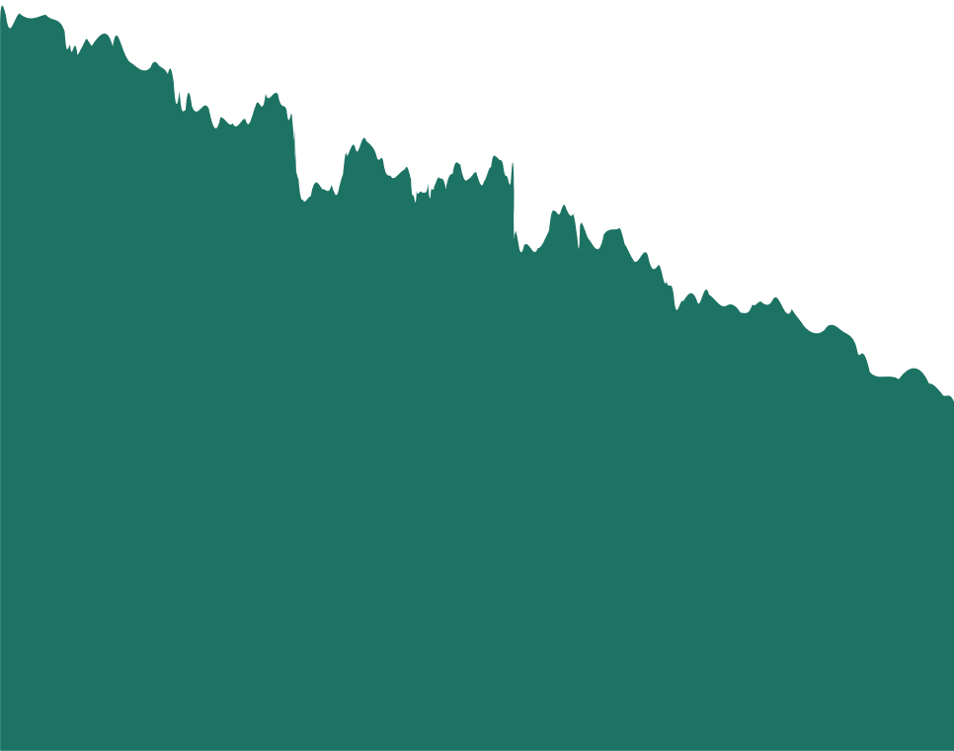
APPLIED STATISTICS AND DATA SCIENCE
Bank Customer Churn Prediction Using Machine Learning Models
Course Code: WM-ASDS04
Semester: Spring 2025

Slide 3


INTRODUCTION OF THE TEAM
PYSLEUTH
Presented By
Supervised By
Khandoker Shawon Mahomud (20251631)
Forkan Amin (20251610)
Mayeesha Farheen (20251641)
Ahammed Reza Khandakar (20251608)
Farhana Akter Bina
Assistant Professor
Department of Statistics & Data Science
Jahangirnagar University

Slide 4
INTRODUCTION
Customer churn-when clients discontinue a bank's services-poses a long-term threat to revenue stability and operational efficiency. In modern retail banking, churn prediction has become a critical analytical function due to increasing competition, evolving customer expectations, and the shift toward digital banking
This study focuses on predicting customer churn using demographic variables, account activity metrics, and card usage behaviour. By combining exploratory analysis with supervised machine learning (specifically Multiple Linear Regression for explanatory insights and Logistic Regression for churn prediction), the study aims to both interpret customer behaviour and build a functional predictive model.

Slide 5
OBJECTIVE OF THIS STUDY
To explore and describe customer demographics and behavioral features associated with churn.
To preprocess, clean and prepare the banking dataset for ML-based analysis.
To apply Multiple Linear Regression (MLR) to understand relationships among continuous usage variables.
To build and evaluate a Logistic Regression model for predicting customer churn.
To generate actionable insights for retention strategies based on model outcomes.

Slide 6


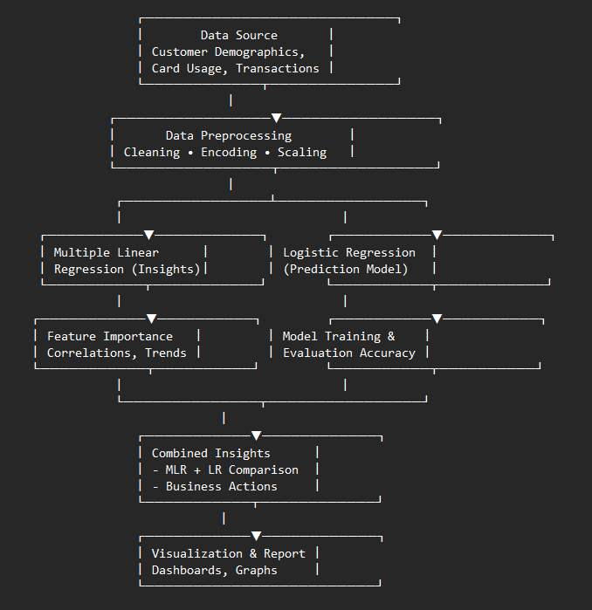
Flow Chart

Slide 7
Implementation Workflow
Python libraries were imported to support data handling, statistical preprocessing, and machine learning operations.
A MySQL connector established a secure and reliable interface for retrieving data from the database.
The entire analytical environment- Python, dependencies, MySQL connectors, and preprocessing scripts-was containerized using Docker, ensuring that the preprocessing workflow executed identically across different machines without dependency conflicts.
Raw datasets were stored in the MySQL database for centralized management, version control, and auditability.
Datasets were loaded and processed separately for Linear Regression and Logistic Regression tasks, allowing each model to receive a tailored preprocessing pipeline.
The final processed datasets were saved back into the MySQL database, enabling reproducible modeling and streamlined integration with future analytical stages.

Slide 8
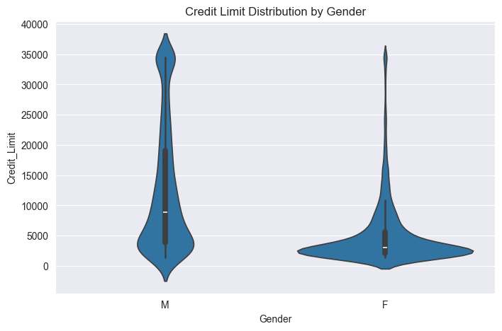
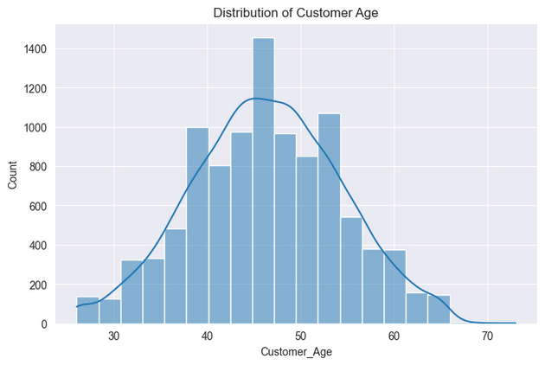
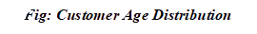
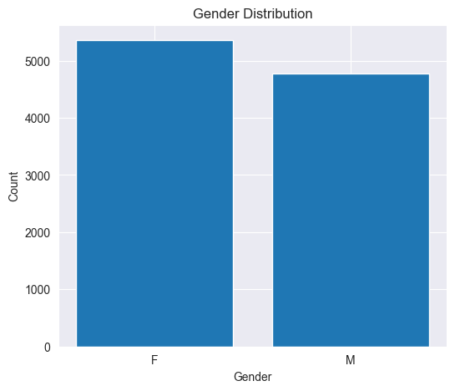
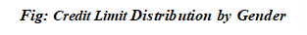
EDA

Slide 9
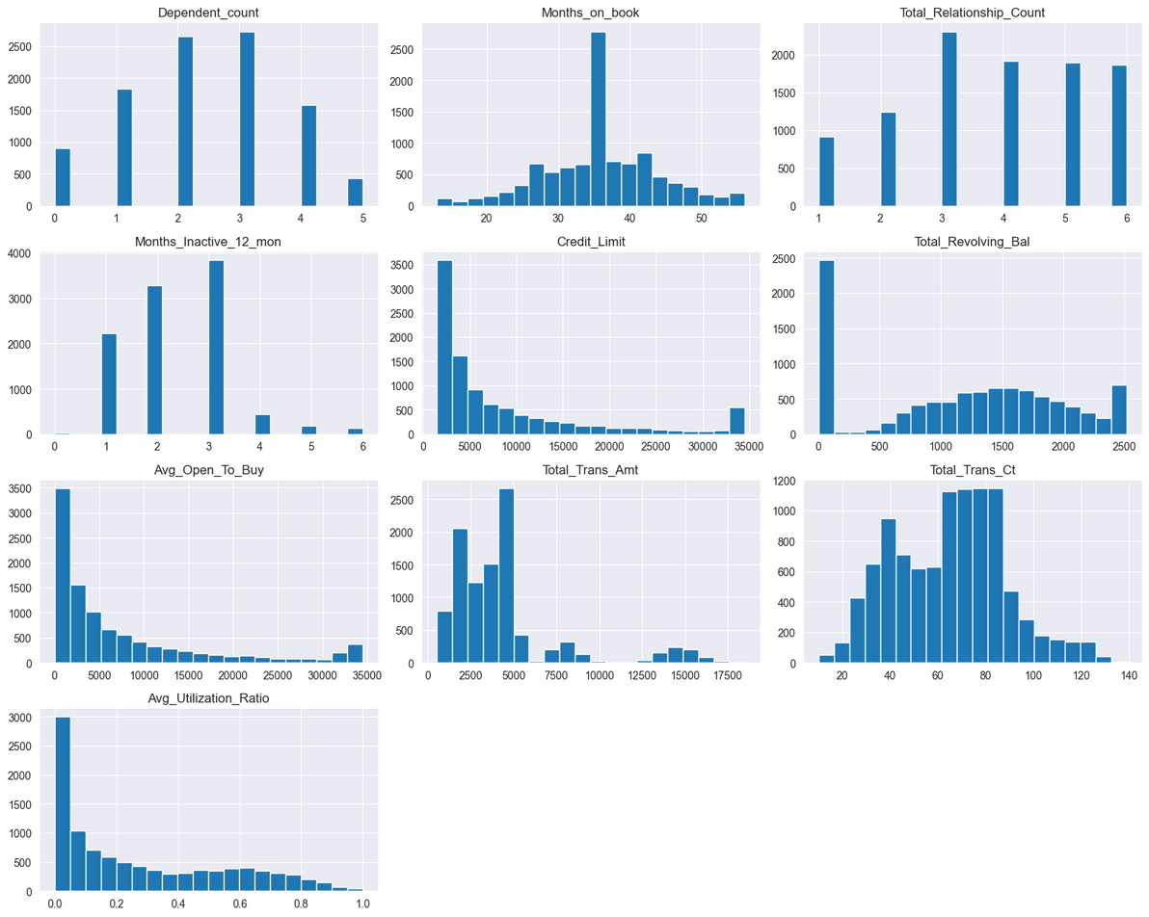
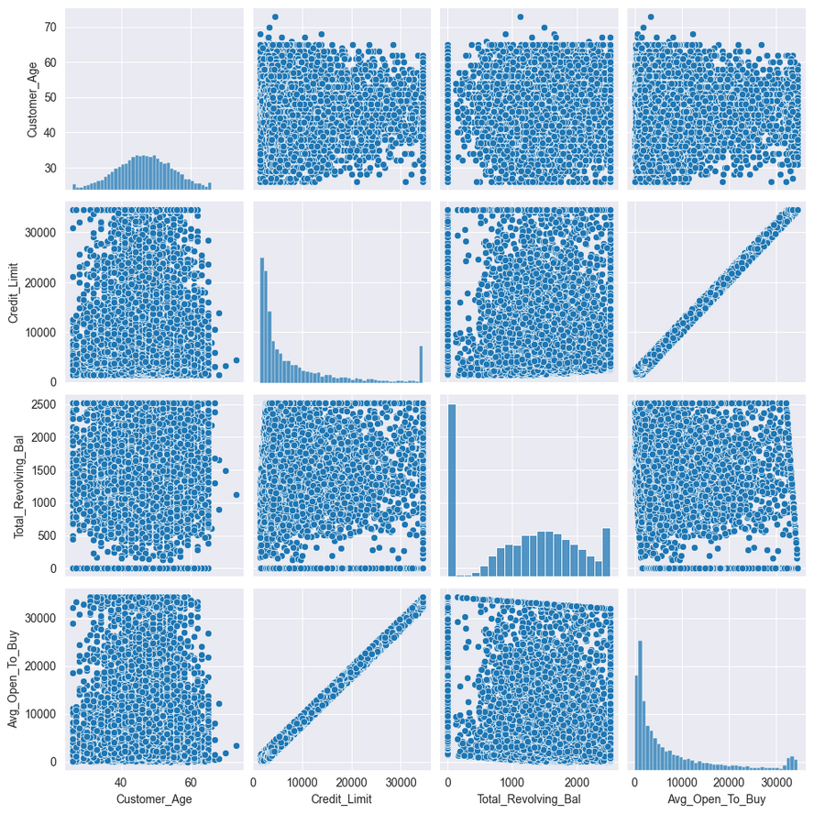
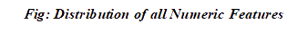
EDA

Slide 10
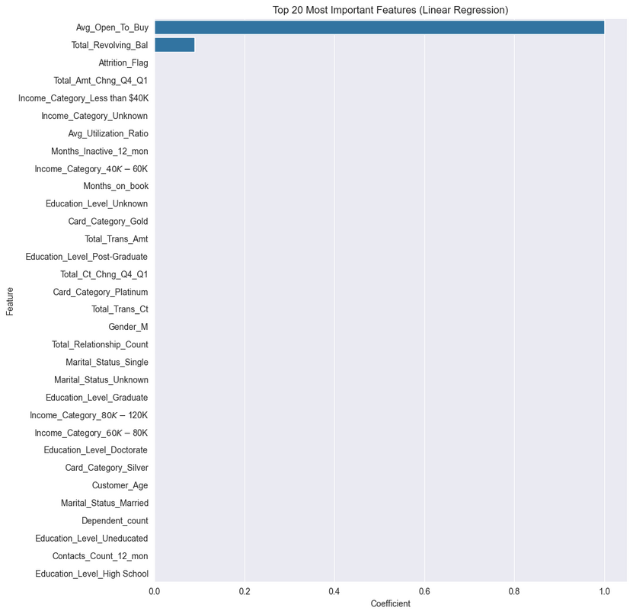
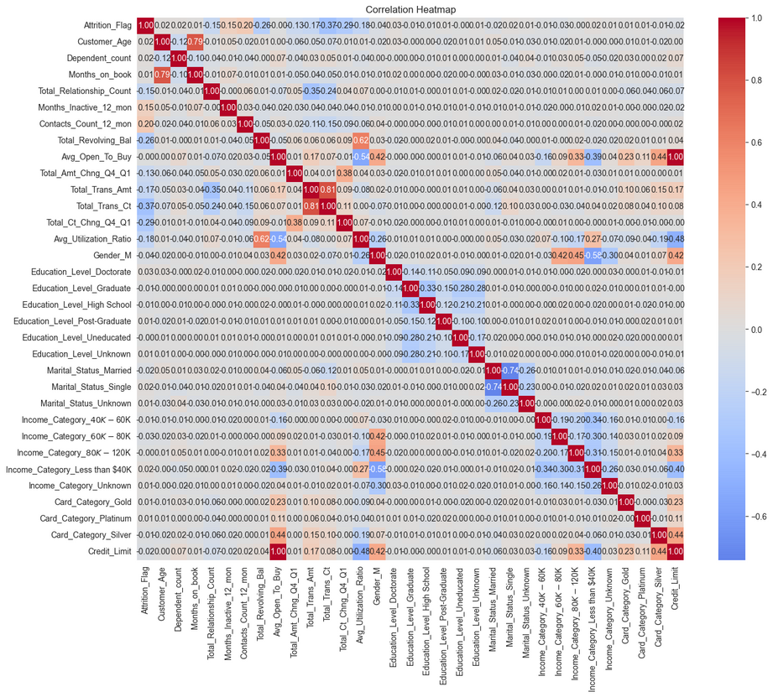
InAb
Multiple Linear Regression
MAE: 0.4488
MSE: 0.3819
RMSE: 0.6180
R^2: 0.6190

Slide 11
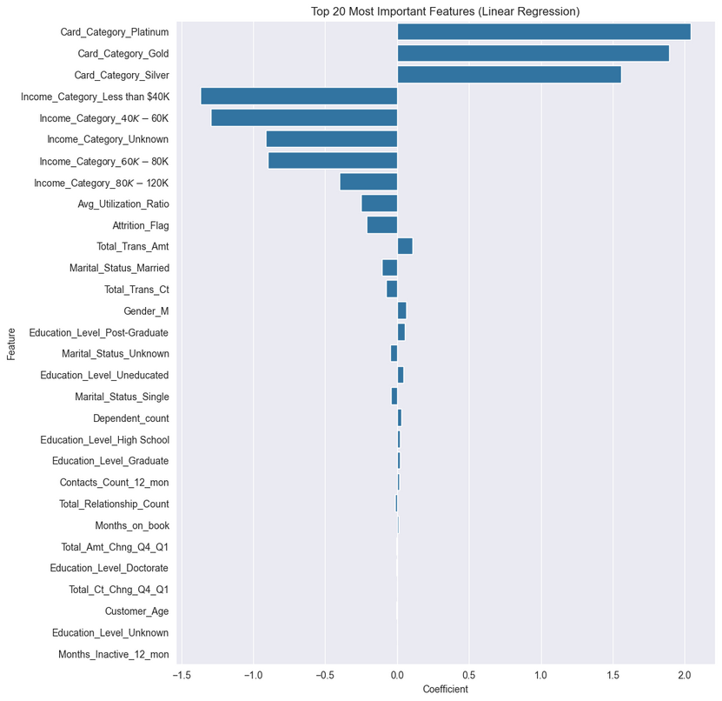
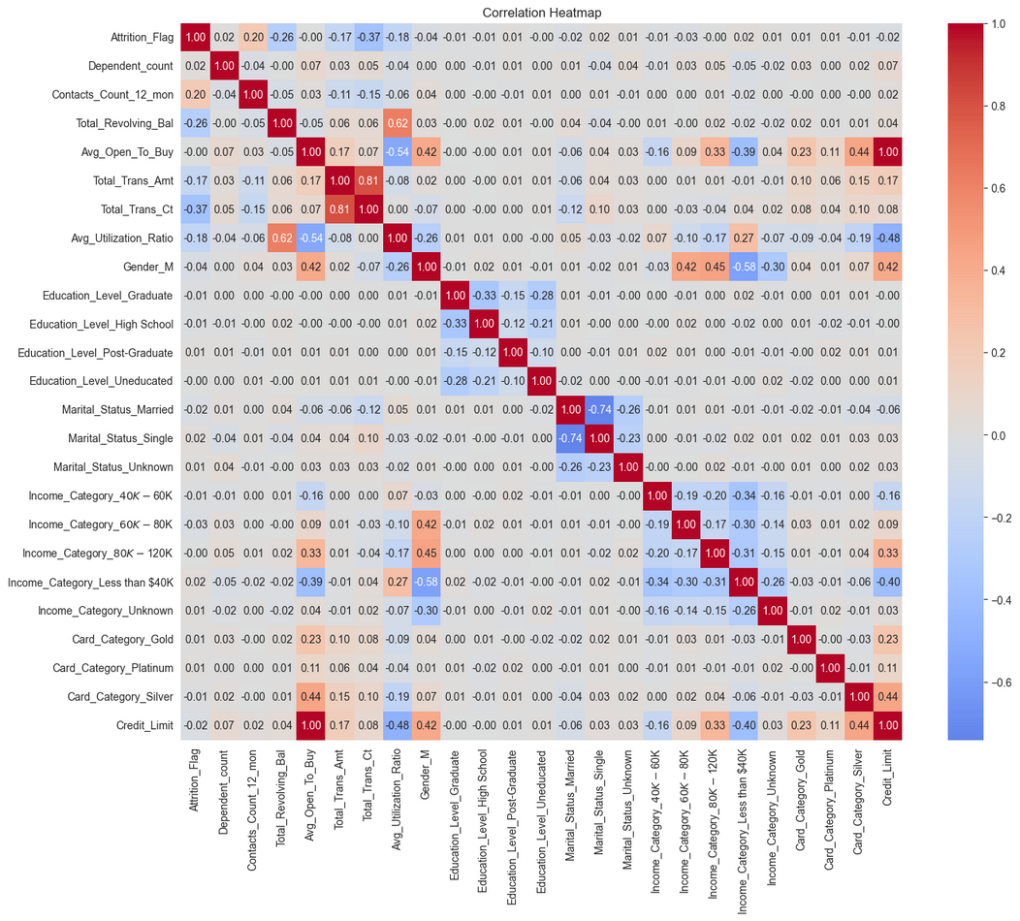
InAb
Multiple Linear Regression

Slide 12
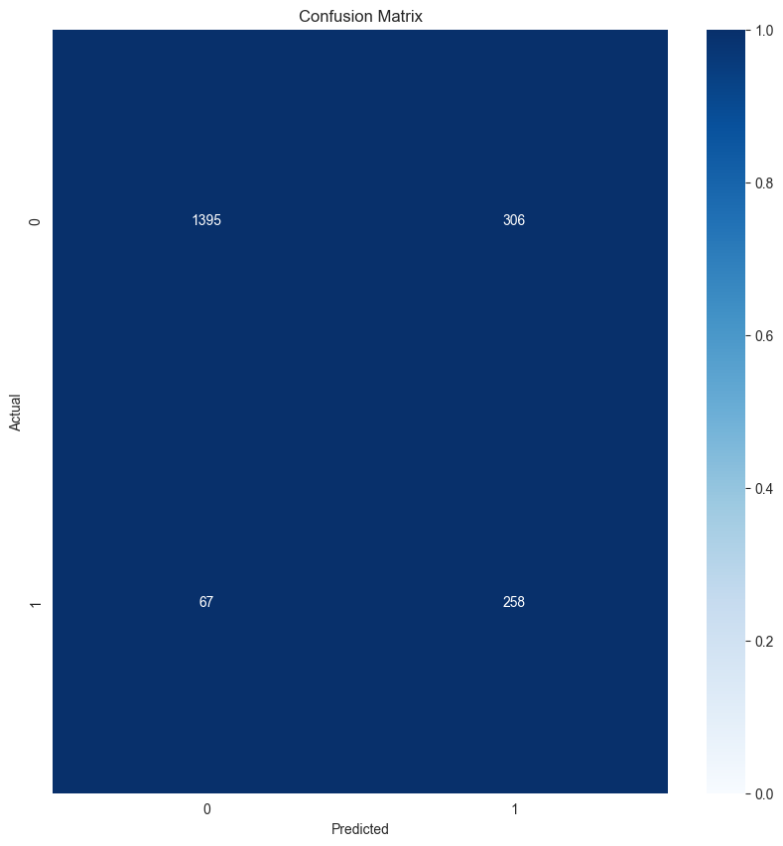
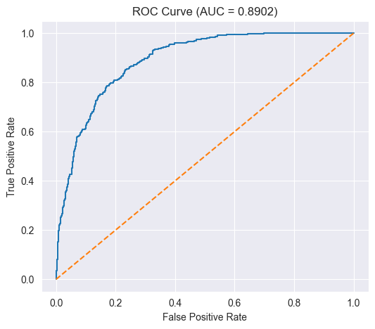
InAb
Logistic Regression

Slide 13
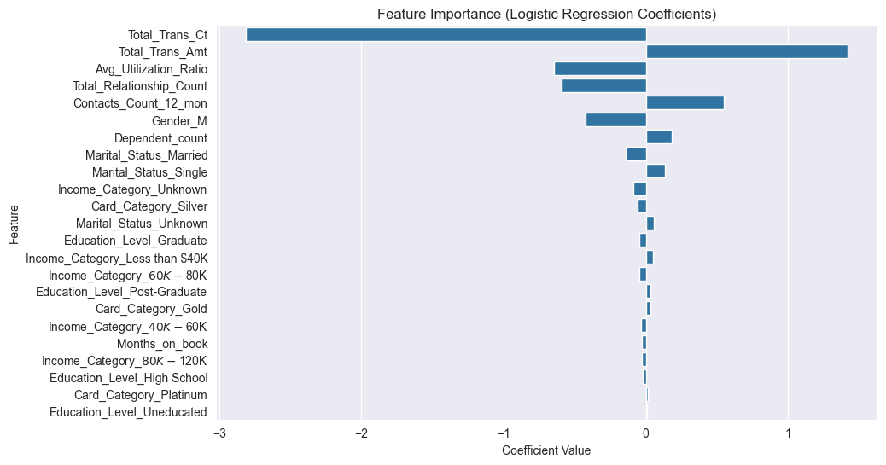
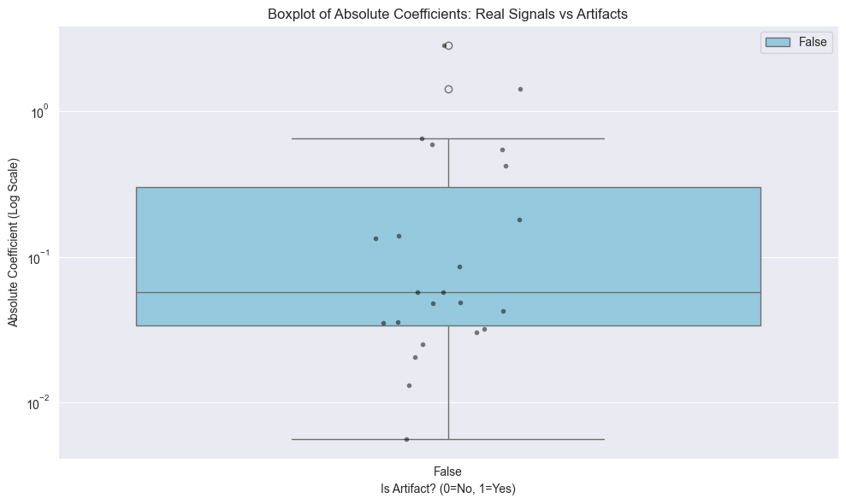
InAb
Logistic Regression
Evaluation using Accuracy, Precision, Recall, F1-score, and ROC-AUC.

Slide 14








Technologies Used

Slide 15
Application of Data Science
Behavioural Insights via EDA & MLR
MLR helped determine patterns in card usage. For example, changes in quarterly transactions were found to be a strong behavioural indicator of customer dissatisfaction.
Predictive Modeling using Logistic Regression
The logistic model assigned a churn probability to each customer, allowing the bank to rank customers according to risk. High-probability customers can be targeted with retention strategies such as personalized offers or service quality interventions

Slide 16
InAb
Conclusion
1. Our linear regression shows that ~75% of a customer’s credit limit is explained by just two things:
Which card tier they were approved for (Platinum → highest limits)
Their declared income bracket (higher income = much higher limits)
Utilization and churn behavior have small effects. Age, tenure, education, number of products — almost zero impact once card type and income are known.

Slide 17
InAb
Conclusion
Our final churn prediction model (ROC-AUC 0.89, Recall 79–85%) can identify the vast majority of at-risk customers months before they leave.
Churn is almost entirely a behavioral problem: Sudden collapse in transaction frequency (by far the strongest signal) Very low or zero card usage Frequent complaints/customer-service contacts Long inactivity streaks. Having few products with the bank Demographics contribute almost nothing once behavior is known. We have removed the three leaking features (Total_Revolving_Bal, Avg_Open_To_Buy, Credit_Limit) that previously gave us a fake 95% accuracy.

Slide 18
InAb
Further Studies
Add temporal analysis: Incorporate time-series or sequence models to capture early behavioral shifts before churn.
Expand dataset: Include richer behavioral, engagement, and macro-economic features for stronger generalization.
Advanced modeling: Explore non-linear and deep learning models (XGBoost, LSTM, Transformers) for complex patterns.
Customer segmentation: Identify churn personas to design targeted, data-driven retention strategies.
Model monitoring: Implement drift detection and periodic retraining to maintain long-term model stability.

Slide 19

InAb
Grateful for your kind Attention

